Slide 1
Angular 10 Training
Nguyen Nhu Tuan
Lotus Team

Slide 2
Content
HTML, CSS, JS
SASS
ES6 features
Typescript
Browser special features
Angular
Unit Test in Angular (Next time)
E2E in Angular (Next time)

Slide 3
HTML, CSS, JS
https://www.w3schools.com/html/
https://www.w3schools.com/css/
https://www.w3schools.com/js/

Slide 4
SASS
https://www.w3schools.com/sass/

Slide 5
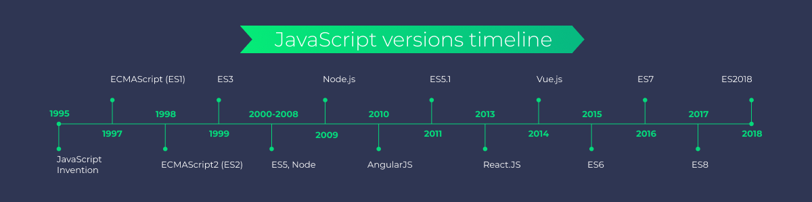
ECMAScript 2015 - ES6
History of JS
  Latest version is “ECMAScript 2018”

Slide 6
ECMAScript 2015 - ES6
New Features in ES6
  See more https://www.w3schools.com/js/js_es6.asp
  let keyword (angular-tutorial/es6/let.js)
  const keyword (angular-tutorial/es6/const.js)
  Arrow Functions (angular-tutorial/es6/arrow-function.js)
  Rest parameter (angular-tutorial/es6/rest-parameter.js)
  Class (angular-tutorial/es6/class.js)
  Promise (angular-tutorial/es6/promise.js)

Slide 7
  Typescript
Types
Control Flow Statements
Functions
Classes
Interfaces
Advanced Types
Generics
Modules
https://www.typescripttutorial.net/

Slide 8
Browser special features
Shadow DOM
History Push Sate

Slide 9
Angular

